Slide 1
TEMPERATURE CONTROL WITH STM32F407 USING STM32CubeIDE
Submitted BY ABHIJITH PAVITHRAN
MASTER OF ENGINEERING IN INFORMATION TECHNOLOGY
SRH HOCHSCHULE HEIDELBERG HEIDELBERG, GERMANY
11018118@STUD.HOCHSCHULE-HEIDELBERG.DE
MATRICULATION NO : 11018118

Slide 2
CONTENTS
ABSTRACT
INTRODUCTION
MATERIALS USED
IMPLIMENTATION
CONCLUSION

Slide 3
ABSTRACT
In this project implemented a temperature controlled fan using DHT11 sensor and STM32F407. We will use the DHT11 sensor to get the temperature value and we will print this temperature value on the OLED. Then we will check if the temperature value is greater than 22 or not, if the temperature will be greater than 22 an LED introduced which blink and the STM32 will be activated and the fan will start to rotate. If the temperature is less than 10 degree an LED will blink which indicate that the temperature is optimum and the fan will be in OFF position.

Slide 4
Introduction
Temperature controlling is required in many places such as Food Industries, Hospitals etc. In this project can be very useful in understanding the basics, how you can control the temperature at your home. This project which can be used anywhere. DHT11 is a Temperature and humidity sensor which as the name implies is used to measure the atmospheric temperature. Here the Temperature controlled fan will act to the temperature changes. The 2 LEDs introduced in this project which indicates the temperature condition.

Slide 5
Materials used
STM32F407 Discovery board
DHT – 11 Temperature sensor
OLED (128 *64)
LEDs
DC fan 5v
Breadboard
Jumper wires

Slide 6
ImPLIMENTATION
In the first step, the sensor senses the temperature by temperature sensor DHT11. Then the sensor's output is taken and conversion of temperature value into a suitable number in Celsius scale is done. For this we need to define the port and the pin where the data of temperature sensor is connected. Then write the function to send start signal. At first the MCU will pull the pin low and keep it low for 20 milli seconds. Then MCU will pull the pin high and keep it high for 30 micro seconds. After receiving the start signal DHT11 sends response to the MCU , then it will pull the line low for 40 micro seconds, then DHT11 pulls up the voltage for 80 micro seconds then transmit the response. Now DHT11 will send 40 bits of data. Each bit’s transmission begins with low-voltage-level that last 40 micro seconds(ie wait for the pin to go high), the following high-voltage-level signal’s length decides whether the bit is “1” or “0”. Then start the timer and initialize the OLED.

Slide 7
The 40 bits sent by DHT11 are as follows
DATA = 8 bit integral RH data + 8 bit decimal RH data + 8 bit integral T data+8 bit decimal T data + 8 bit checksum.
If the data transmission is right, check-sum should be the last 8 bit of “8 bit integral RH data+8 bit decimal RH data+8 bit integral T data+8 bit decimal T data”
If the data transmission is not right then the OLED display “ Data Error”.
The STM32F407 I2C pins PB6 and PB7 are connected with the SCL and SDA pins of OLED.
Then print the temperature on the OLED display.
After that initialize a condition such as if temperature equal or greater than 22 degree celsicus an LED which ic connect to the GPIO port A pin 1 of MCU will blink ie indicating the increased level of temperature.
A dc fan of 5v is also connected with the GPIO pin in order to optimize the temperature.
Correspondingly if the temperature is below 22 degree Celsius an LED will blink which represent the optimum level of temperature.
:

Slide 8
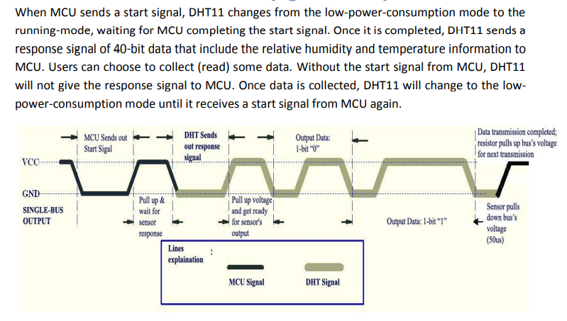
Overall communication of DHT - 11
ImPLIMENTATION

Slide 9
conclusion
In this project, successfully implemented a temperature-controlled fan circuit. Using an STM32F407, DHT11, and few other components.
During winter season many food industries faces problems related to the temperature variation which can be reduced by implementing this project.

Slide 10

THANK YOU!

